Slide 1

Dealing with Temporal Drift and Domain Shift
Rayid Ghani

Slide 2
Reminders
Coming up:
Classes
ML Ops (next week) – skim through the readings to have a class discussion
Assignments
Submit your updates anytime before Dec 2 to get full points
Module 2 assignment due Dec 2
Presentations on Dec 2 and 4 (will announce slots Thursday – randomly assigned)
Final reflection writeup due Dec 10

Slide 3
Scope
Data
Exploration
Modeling
Get Data
Store Data
Link Data
Rows
Features
Labels
Model Selection
Train-Test Splits
Performance Metrics
Model Interpretation
Entities
temporal
Spatial
…
Models
Dealing with Bias and Fairness
Field Trial Design
Deployment
Monitoring
Goals, Actions, Data, Analysis, Ethics

Slide 4
Focus of today: Temporal Drift and Distribution Shift
Why do we care about it?
What is it?
Why it happens?
How can we detect it?
How can we deal with it?

Slide 5
Why do we care about temporal/domain drift/shift in ML?
Go back to our conversation on failures of ML Systems
Examples
Fraud
Covid
Trump

Slide 6
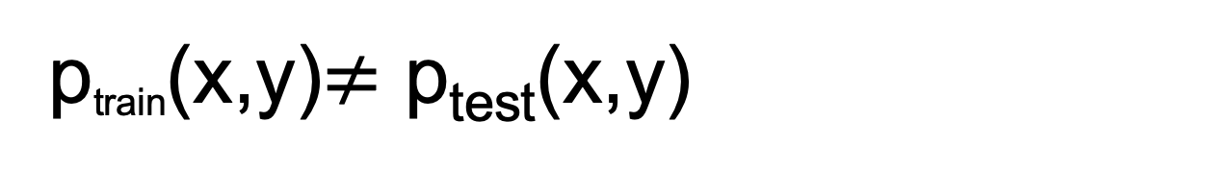
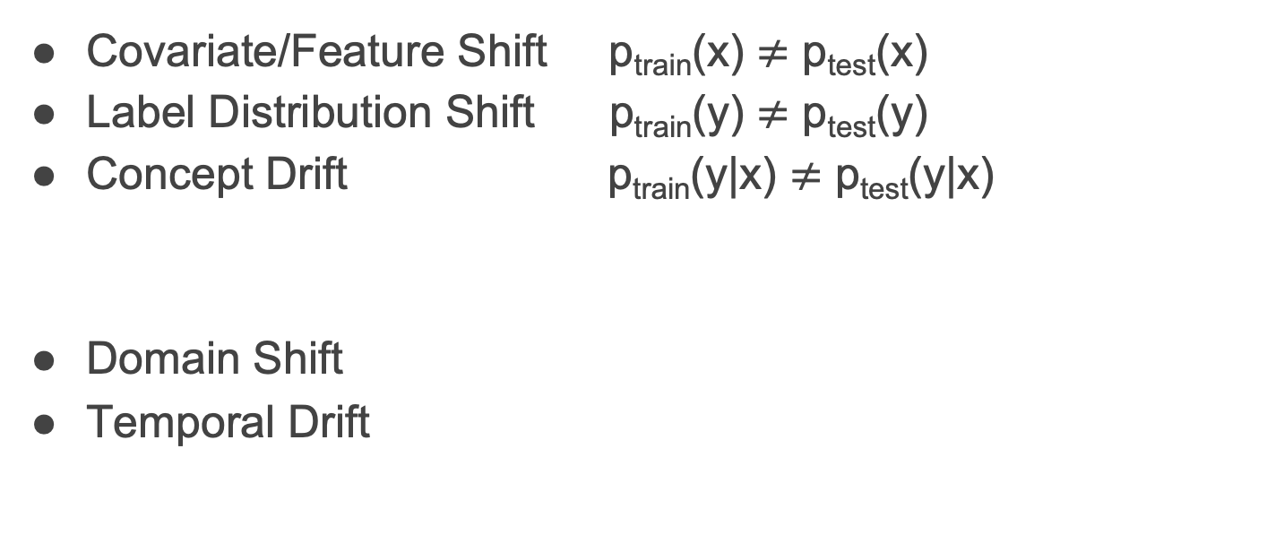
Types of Drift and Shifts
p_{train}​(x,y)$≠$ p_{test}​(x,y)
Covariate/Feature Shift p_{train}​(x) $≠$ p_{test}​(x)
Label Distribution Shift p_{train}​(y) $≠$ p_{test}​(y)
Concept Drift p_{train}​(y|x) $≠$ p_{test}​(y|x)
Domain Shift
Temporal Drift

Slide 7
Poll on examples on different types of drift

Slide 8



Do not edit How to change the design
Can you give an example in the real world of each type of drift happening? Feature Drift Label Distribution Drift Concept Drift
The Slido app must be installed on every computer you’re presenting from

Slide 9
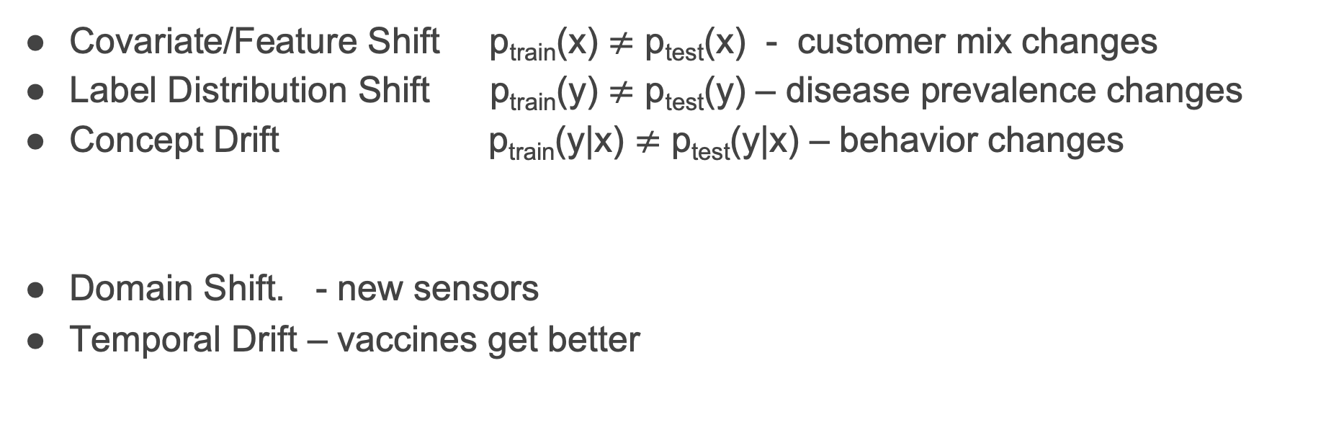
Types of Drift and Shifts
p_{train}​(x,y)$≠$ p_{test}​(x,y)
Covariate/Feature Shift p_{train}​(x) $≠$ p_{test}​(x) - customer mix changes
Label Distribution Shift p_{train}​(y) $≠$ p_{test}​(y) – disease prevalence changes
Concept Drift p_{train}​(y|x) $≠$ p_{test}​(y|x) – behavior changes
Domain Shift. - new sensors
Temporal Drift – vaccines get better

Slide 10
Behavioral changes
User preferences evolve.
fraud tactics change.
Patients respond differently to treatment as medicine changes.
External shocks
COVID, recessions, regulatory shifts, natural disasters.
System interactions and Feedback loops
ML models influence behavior → performative prediction (people change because of the model).
Policing models → more patrols → more arrests → more predicted crime.
Loan models → denials → people disappear from training data.
System and Data pipeline changes
New sensors, new data schemas, A/B tests, feature deprecation.
Market dynamics
Competitive incentives shift (ads bidding, fraud adaptation, pricing changes).

Slide 11
How do we detect it?
By Monitoring
What/How do we monitor?
Performance of model?

Slide 12
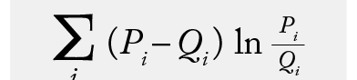

Monitoring Feature/Covariate Shift
p_{train}​(x) $≠$ p_{test}​(x)
Univariate Tests
KL-divergence
Population Stability Index
KS, Wasserstein distance, …
Multivariate Tests
Build classifier to differentiate between train and test

Slide 13

Monitoring Label Distribution Shift
p_{train}​(y) $≠$ p_{test}​(y)
Univariate tests

Slide 14

Monitoring Concept Drift Distribution Shift
p_{train}​(y|x) $≠$ p_{test}​(y|x)
Non-trivial to detect given that we don’t have labels for all the test data or they take time to get
Prediction Score drift
Performance/Error monitoring
Error Analysis
Feature importance drift

Slide 15
In Practice: The scale is large
serve millions of predictions per second
operate on non-stationary environments
receive continuous feedback loops
must avoid interrupting mission-critical systems
real-time or near-real-time
automated and scalable
highly granular (feature-level, model-level, segment-level)
versioned and traceable
human-override-friendly

Slide 16
In Practice: Monitoring
Data Pipeline monitoring (Deequ library) - changes in schema, missing, data types, new values
Feature Pipeline monitoring (Great Expectations library)
Model monitoring (list of tools) - pre-deployment shadow models
Outcome/Label monitoring (for evaluation and monitoring)

Slide 17
In Practice: What happens if monitoring alerts
On-call staff
Retrain?
Override?
Escalate?
Roll back?
Other fixes?

Slide 18
How do we deal with it?
Robust models (temporal features: rolling window features, recent historical aggregates, time decayed features allow model to adapt)
Robust model selection (temporal model selection or deployment aware model selection)
Retraining (regular – at what schedule?, triggered, online)
Why is “always updating” a bad idea?
Adaptation (fine-tuning, importance weighting)
Uncertainty estimates

Slide 19
Resources
Python package: https://github.com/SeldonIO/alibi-detect
Blog post: https://huyenchip.com/2022/02/07/data-distribution-shifts-and-monitoring.html
Other packages in slides for drift monitoring

